Slide 1

Basic Details of the Team and Problem Statement
Ministry/Organization Name/Student Innovation: Ministry of Textiles
PS Code: SIH1309
Problem Statement Title: Application Development for monitoring of wool from Farm to fabric
Team Name : SYNTAX SQUAD
Team Leader Name: Arjun Kumar Institute Code (AISHE) : C-26855
Institute Name: Audisankara college of engineering and technology
Theme Name:Transportation & Logistics

Slide 2
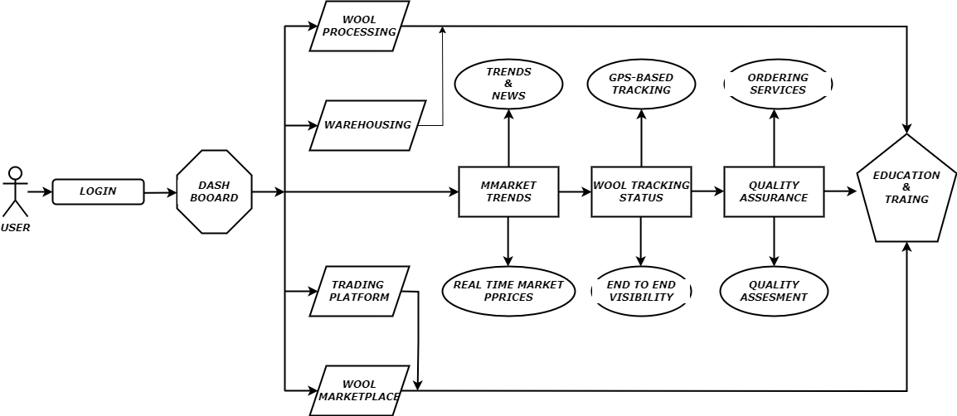








Idea/Approach Details
ARCHITECTURE
Farmers in the wool production industry face several challenges and problems like Market Access and Price Volatility, Quality Control, Traceability and Transparency, Market Trends and Demand.
Market Access: Access to the wider market can be facilitated through the application.
Financial Management: The application can assist in financial management, including cost tracking, revenue monitoring, and budgeting
Traceability of wool from farm to fabric can provide assurance to buyers and consumers about the origin and quality of the wool
Training Resources: Offer training materials and resources to help farmers adopt technology and best practices.
TECHNOLOGY STACK:

Slide 3
Describe your Dependencies / Show stopper here
Idea/Approach Details
Use Cases
Third-Party APIs Integration with external services, such as geolocation services, market data APIs, or weather data providers, depends on the availability and reliability of these APIs
Farm Data The project relies on accurate and timely data from wool-producing farms, including information about animal health, shearing schedules, and wool quality
Market Data Access to market data and pricing information is crucial for farmers and stakeholders to make informed decisions
Market dynamics such as supply and demand for wool, consumer preferences, and global trade conditions, are dependencies that can influence project outcomes
Training and support resources must be available to help farmers and users effectively use the monitoring application
Budgeting and Cost Tracking Assist farmers in managing their finances by tracking expenses, revenue, and budgeting
Origin Tracking Provide consumers and buyers with the ability to trace the origin of wool products back to the farm, enhancing transparency and trust
Marketplace Integration Connect farmers with processors, manufacturers, and buyers looking for specific types of wool
Logistics and Transportation Optimize logistics and transportation within the supply chain to reduce costs and improve efficiency
Shearing Management Schedule and coordinate shearing activities, ensuring that wool is harvested at the right time
CHANNELS : Govt portals , Organizations , Industries

Slide 4
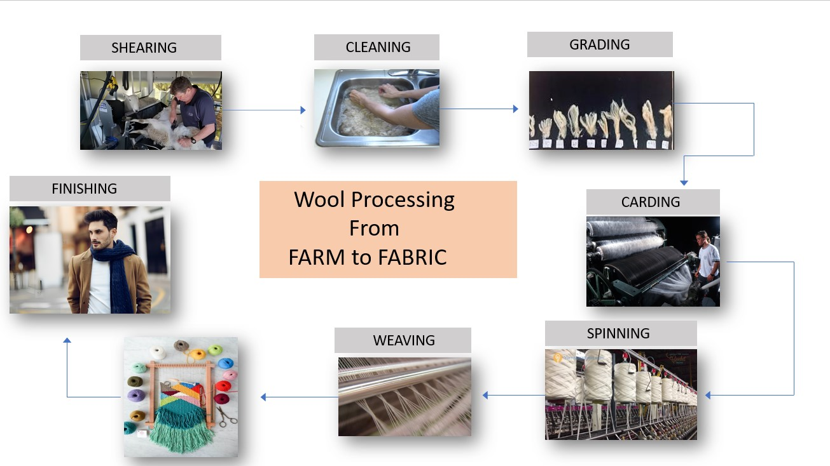
PROCESS
SHEARING

Slide 5
Team Member Details
Team Leader Name: Arjun Kumar
Branch (Btech) Stream (CAI) Year (III)
Team Member 1 Name: Shaik Jasmine
Branch (Btech ) Stream (CSE) Year (III) Team Member 2 Name: Molakala Mohan Krishna Branch (Btech) Stream (CAI ) Year (III) Team Member 3 Name: Shaik Aafreen
Branch (Btech ) Stream (CSE ) Year (III)
Team Member 4 Name: Vusa Yaswanth
Branch (Btech) Stream (CAI ) Year (III) Team Member 5 Name: Sannala Venkata Suneel Branch (Btech ) Stream ( CAI) Year (III) Team Mentor 1 Name: B . Hari babu
Category (Academic ) Expertise : A I & M L
Team Mentor 2 Name: K . KAVITHA
Category (Academic):
Domain Experience (in years):10 years
Expertise : D B M S
Domain Experience (in years):3 years

